Slide 1
STOCK MARKET PREDICTION USING MACHINE LEARNING MASTER THESIS
->DINESH KUMAR S – 22MCA0021
Guide – Prof. Mythili N

Slide 2
ABSTRACT :
AI/ML can be used to analyze trends and patterns in financial data to make predictions about future investment opportunities. By using historical data and advanced algorithms, AI/ML can identify market trends and predict potential investment opportunities. This can help investors make informed decisions and minimize risk.

Slide 3
EXISTING SYSTEM :
The existing system for stock market prediction primarily relies on human analysis, fundamental and technical analysis
Traders and investors face challenges in responding swiftly to market changes and optimizing their portfolios.

Slide 4
PROPOSED SYSTEM :
Our proposed work involves collecting historical data related to the asset or market of interest and preprocessing it to ensure data quality. We then engineer relevant features and train an Multiple model using the preprocessed data. The model's performance is evaluated using appropriate metrics, and adjustments are made to optimize its accuracy. Finally, we leverage the trained model to forecast trends and develop an investment strategy.

Slide 5
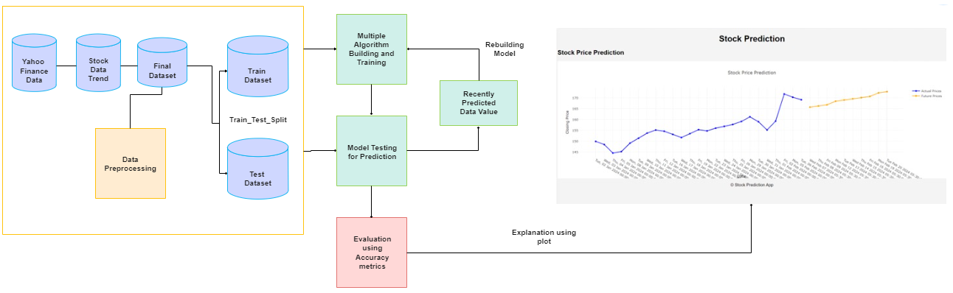
ARCHITECTURE DIAGRAM :

Slide 6
REQUIREMENTS :
Hardware Requirements :
RAM - 8 GB
GPU – NVIDIA
Internet Connectivity – 50 kb/s (Min)

Slide 7
REQUIREMENTS :
Software Requiements :
Operating System – Windows/ MacOS / Linux
Programming Language – Python, Html, CSS
Framework – Flask
Tools – Visual Studio Code, Google Colab

Slide 8
PROJECT PHASE:
Collecting Real-Time Data
Data Pre-Processing
Choosing the Model
Splitting the Dataset into Training and Testing
Implementation
Evaluating the performance
Virtualizing the output

Slide 9
DATASET SAMPLE :
Date | Open | High | Low | Close | Adj Close | Volume | Stock Name
2024-01-02 00:00:00 | 151.54 | 152.38 | 148.39 | 149.93 | 149.93 | 47339400 | AMZN
2024-01-03 00:00:00 | 149.2 | 151.05 | 148.33 | 148.47 | 148.47 | 49425500 | AMZN
2024-01-04 00:00:00 | 145.59 | 147.38 | 144.05 | 144.57 | 144.57 | 56039800 | AMZN

Slide 10
REAL-TIME DATA:
Utilize the Yahoo Finance API to fetch real-time stock market data, including stock prices, trading volumes, market indices, and company information.
Implement a data retrieval process that periodically fetches updated data to ensure that the dataset remains current and reflective of the latest market conditions.

Slide 11
DATA PRE-PROCESSING:
Cleanse the collected data by handling missing values, outliers, and inconsistencies to ensure data quality and integrity.
Perform feature engineering to extract relevant features from the raw data, such as moving averages, technical indicators, and sentiment scores, to enhance predictive modeling.

Slide 12
CHOOSING MODEL :
Linear Regression:
Linear regression is a simple yet effective model for predicting numerical values, such as stock prices, based on linear relationships between predictor variables (features) and the target variable (stock price).
It assumes a linear relationship between the input features and the output, making it easy to interpret and implement.
Moving Average:
Moving average is a commonly used technique in time series analysis for smoothing out fluctuations in data and identifying trends over time.
It calculates the average of a specified window of past data points and uses this average to make predictions for future values.

Slide 13
SPLITTING DATASET
Divide the dataset into training and testing sets, typically using a common split ratio such as 80% for training and 20% for testing.
Implement a time-based splitting strategy to ensure that training data precedes testing data, reflecting the chronological order of real-world data.

Slide 14
IMPLEMENTATION PHASE:
Develop a web application using Python Flask framework to host the stock market prediction model and provide a user-friendly interface for users to interact with.
Create routes and endpoints in Flask to handle incoming requests from clients, such as fetching real-time data, making predictions, and serving the results back to the user interface.

Slide 15
EVALUATING THE PERFORMANCE :
Measure the performance of the trained models using appropriate evaluation metrics for regression tasks, such as mean squared error (MSE), root mean squared error (RMSE), mean absolute error (MAE), and R-squared (R^2) coefficient.
Compare the performance of different models and configurations to identify the most effective approach for stock market prediction based on the evaluation results.

Slide 16
VISUALIZING THE OUTPUT :
Generate visualizations, such as line charts, scatter plots to illustrate the predicted stock prices against the actual values and visualize the model's performance.
Use interactive visualization tools or dashboards to present the results dynamically, allowing stakeholders to explore and analyze the predictions based on different parameters and time periods.

Slide 17
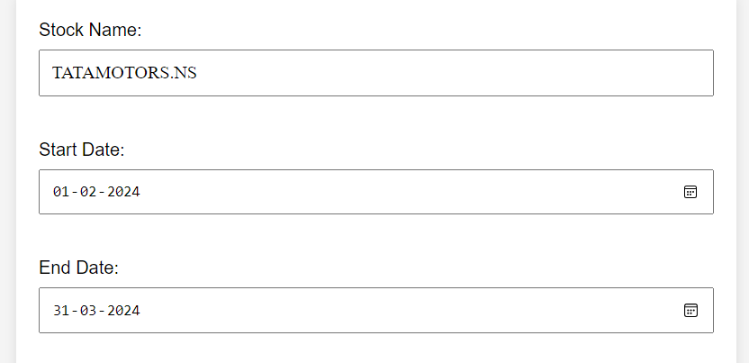
RESULT :

Slide 18
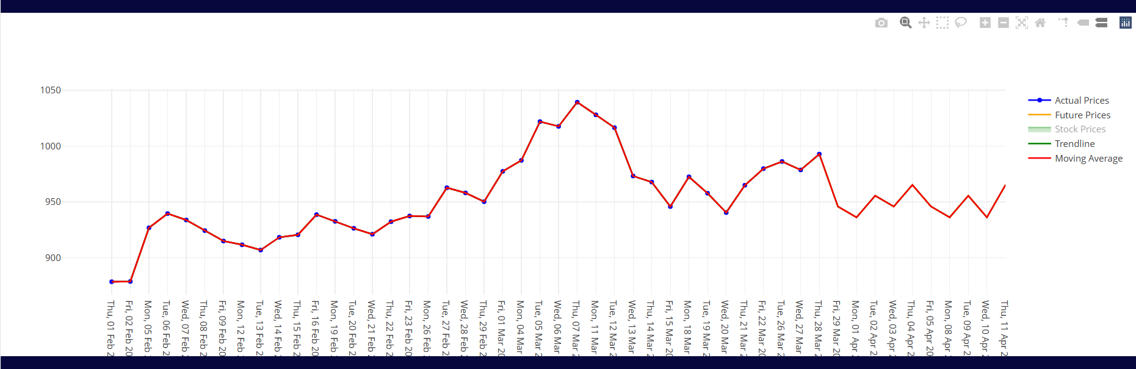

Slide 19
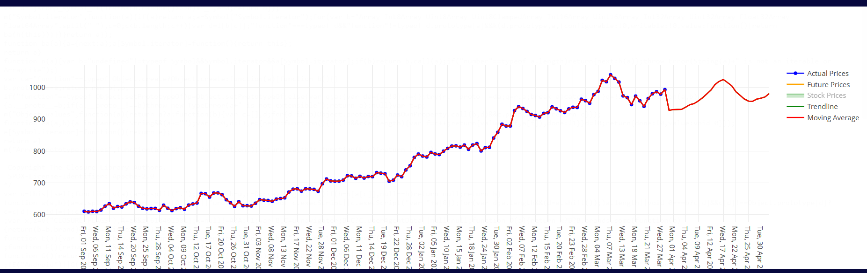

Slide 20
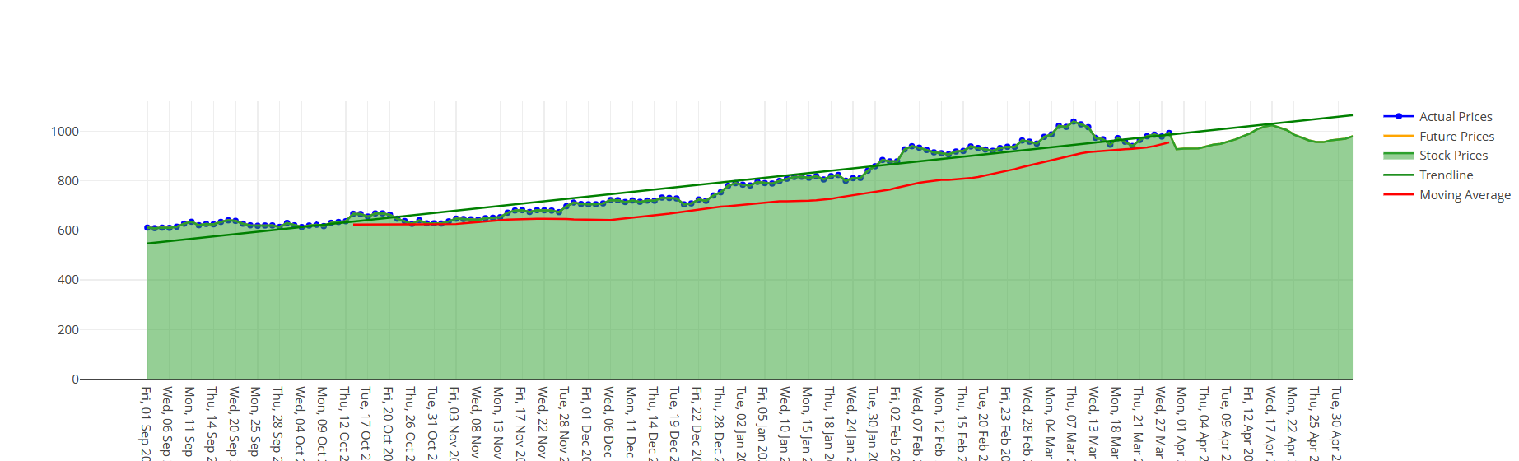

Slide 21
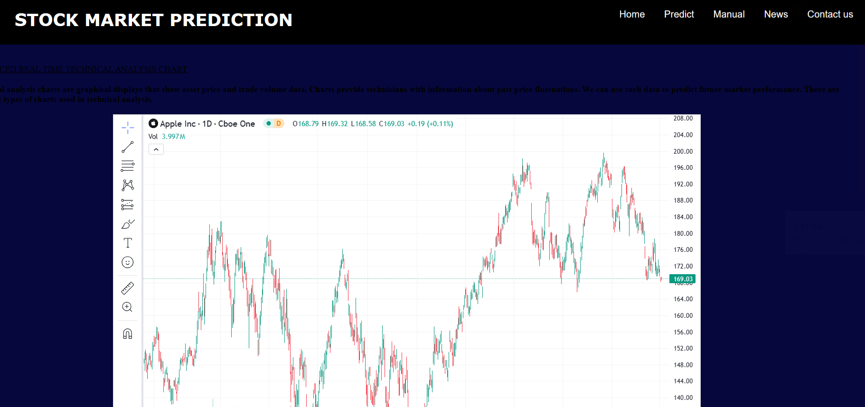

Slide 22
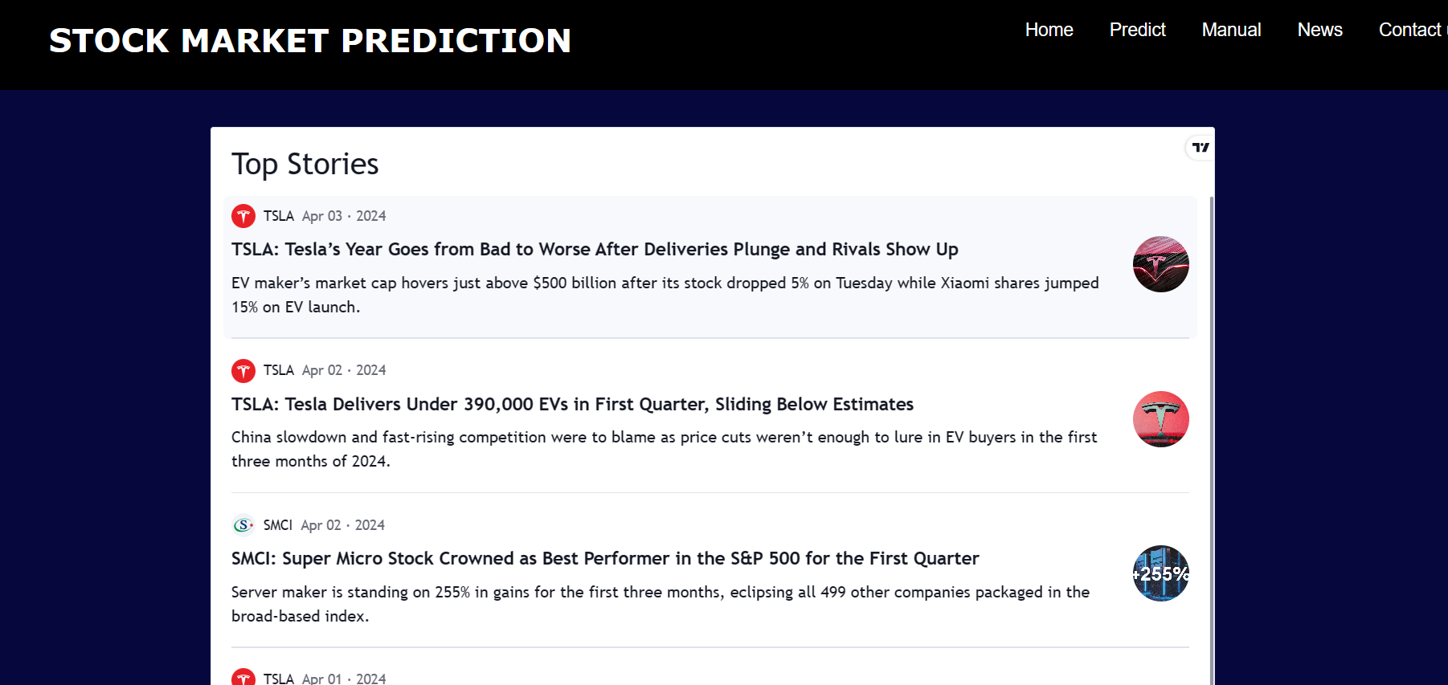

Slide 23
Thank You

